Slide 1

Ruby Language

Slide 2
About today…
Control structures
Types of Control Structures
Conditional Statements

Slide 3
Control Structures
Control structures are programming constructs that dictate the flow of execution based on conditions and logic
Essential for :
making decisions
repeating tasks
handling different scenarios in code

Slide 4
Types of Control Structures
Conditional Statements
Executed based on conditions
if-else
case
Looping Structures
Repeat code blocks until a condition is met
while
for

Slide 5
Conditional Statements
Execute different code blocks based on specified conditions
Types
if
if-else
elsif
case-when

Slide 6

if statement
if the given condition is true, executes the block of statements
Syntax

Slide 7
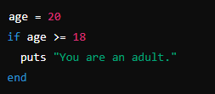

Example
Output

Slide 8
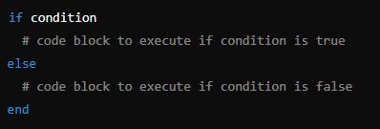
if-else statement
if the given condition is true, executes first block, otherwise execute second block
Syntax

Slide 9
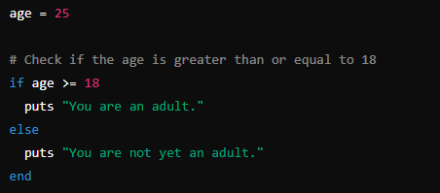
Example
Output

Slide 10
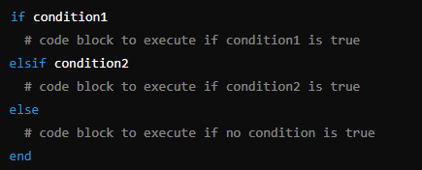
elsif statement
Executes the block of statements whose condition is true, if no condition is true, execute else block
Syntax

Slide 11
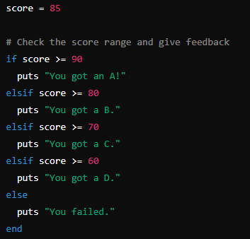

Example
Output

Slide 12
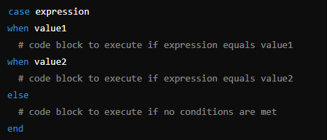
case statement
Executes the block of statements whose value matches the given expression, if no value matches, execute else block
Syntax

Slide 13
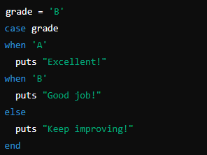

Example
Output

